Slide 1
Pump it Up: Predicting The Operating Condition of Tanzanian Wells
Final Read Out
To see the link between water and food security in Africa, one need look no further than the 2011 drought in the Horn of Africa. – International Committee of The Red Cross

Slide 2
Discussion Topics
Recommendation
Technology
Predictive Model & Technology Comparison
Recommendation
Data
Evaluated several prediction methods, including deep learning
Compared Angoss, Azure, and R
Evaluated visualizing data in Tableau
Evaluated two approaches for addressing missing data
Selected optimal approach
Goal
Optimize well repair resources
Maximize well uptime
Reduce conflicts over water
Make a technology recommendation
Scope
59,400 wells
Across 365,756 square miles
Serving 51.82 million people
International donor pressure to optimize well maintenance

Slide 3
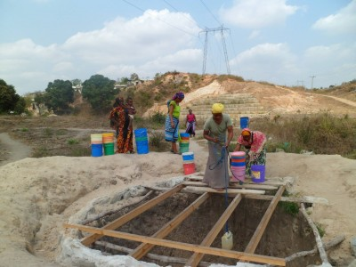

Pump it Up: Predicting The Operating Condition of Tanzanian Wells
Walk Two Hours,
Get bucket of questionable water, walk two hours back. The most basic need in life is clean and available water.
Now imagine doing that day after day after day.
How long would you last last when the well breaks?
We are making a difference by
predicting which wells are likely to fail
optimizing your resources
changing your model from reactive to proactive

Slide 4
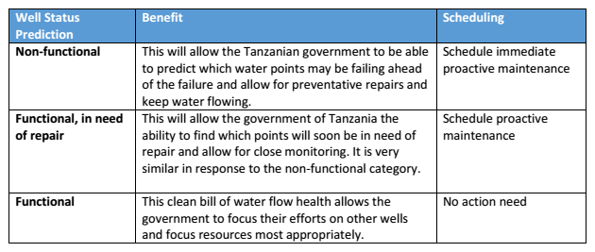
Goal – Predicting Water Well Status
Build a model that will predict a three-fold outcome on status of water wells.

Slide 5
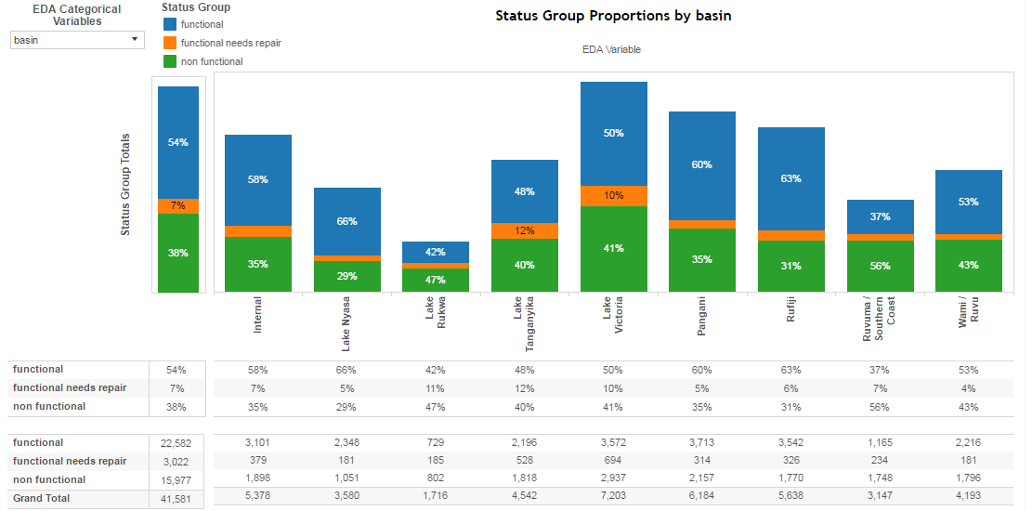
Data
Quality
Data
Transformation
Method
Missing Data
Data Imputation
missForest
(tree-based)
Combine levels with smaller numbers of observations
Group levels with less than a specified percentage of the observations
High Cardinality
Numeric Variables: Center and Scale
Categorical Variables: Dummy Coding
Nonstandard Data
Data Standardization
Exploratory Data Analysis
Enhanced through the creation of an EDA dashboard using Tableau business intelligence software
Allows each team member to perform their own EDA and choose the variables they would like to analyze

Slide 6



Predictive Models
Multiple models were constructed using R, Azure software and Angoss software to identify which performed most favorably with regard to predictive accuracy of the test data
Predictive Model Recommendation: Random Forest Model created using R
R Models | Accuracy – Test Data
Random Forest | 0.8080
Gradient Boosting | 0.8013
Bagging | 0.6964
Deep Learning Neural Network | 0.7688
Support Vector Machine | 0.7893
Multinomial Regression | 0.7477
Azure Models | Accuracy – Test Data
Multiclass Decision Forest | 0.80156
Multiclass Decision Jungle | N/A*
Multiclass Neural Network | 0.781413
Multiclass Logistic Regression | 0.743869
*Exceeded1 Hour of CPU Time
Angoss Models | Accuracy – Test Data
Random Forest | 0.7553
Bagging | 0.7468
Deep Learning Neural Network | 0.736

Slide 7
Modeling Tool Recommendation
Modeling Tool Recommendation: R
Our team currently recommends that the ministry leverage R because of the flexibility in choosing more modeling algorithms, accuracy, and absence of recurring costs
Feature | R | Azure | Angoss
Economics | Free | Recurring costs | License & yearly maintenance fee
Skill Set | Specialized | Average | Average
Timeliness | Low | High | Moderate
Accuracy | High | Out of the box feature - Medium Specialized resources - High Custom extensions in R - High | Out of the box feature - Medium Specialized resources - High Custom extensions in R - High
The below chart includes recommendations on when to use each program
Need | Specification | Technology
Imputing Missing Data | Need to quickly impute data, where a high degree of accuracy is not required | Azure
 | Need a high degree of accuracy when immediacy is not required | R
Model Building | Need reasonably accurate response within hours | Azure
 | Need a high degree of accuracy when immediacy is not required | R

Slide 8
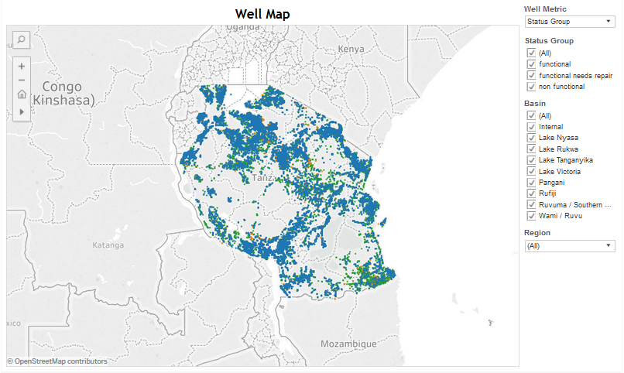
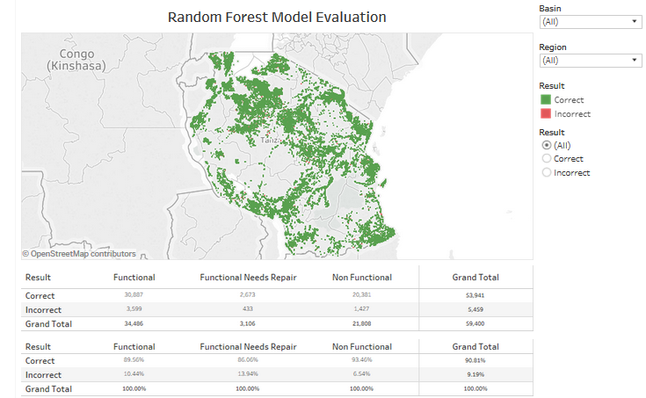
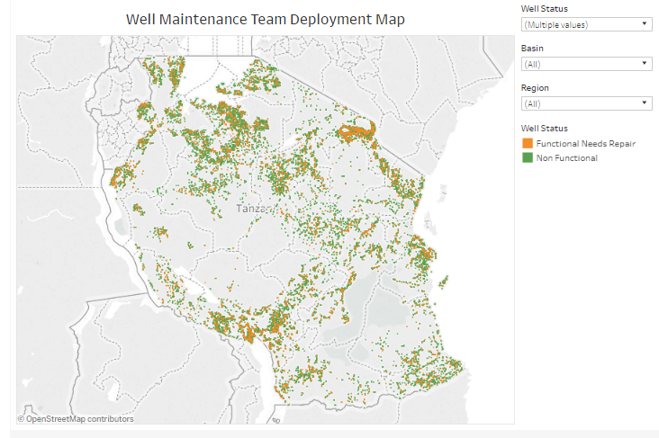
Data Visualization: Tableau
Click Images to View Dashboards
Exploratory Well Map
Random Forest Model Evaluation Map
Well Maintenance Team Deployment Map
Interactive EDA (Slide 3):
Click to Here View
Recommended Next Steps
Database Improvement
Determine missing values and populated when feasible.
Clearly denote which entries are unavailable rather than populating with zeros.
Predictive Model Refresh
Periodic review of the model to ensure that the algorithm used to predict well status is modified when appropriate.
Review of the Azure software option in 18 – 24 months to determine whether it would be a more suitable option at that time.

Slide 9
What Was Delivered
No. | Particulars | 1 | 2 | 3 | 4 | 5 | 6 | 7 | 8
1 | Engagement Letter
2 | Requirements Session
3 | Initial Findings
4 | Final Report
5 | Executive Summary
6 | Executive presentation
7 | Oral Report
Reliable sources of water for farming help communities to feed themselves. In the jargon, they “facilitate food security.”

Slide 10



Engagement Team
Susan Poole, Engagement Manager & Data Scientist
Susan Poole is an actuary for a small Midwestern insurance carrier. She offers technical expertise in data analysis and model construction in R, as well as professional experience in project management and business communications.
Robert Herold, Data Scientist & Visualization Subject Matter Expert
Robert Herold is the Analytics Manager at a small advertising agency that focuses on media planning and buying. His technical expertise includes performing predictive analytics in R, as well data visualization in Tableau.
Chris Pelkey, Data Scientist & Project Manager
Chris Pelkey currently provides legal marketing services. In addition to modeling experience, Chris offers strong writing and presentation skills, as well as project management expertise to the team.
Carlos Fuentes, Data Scientist & Benefits Realization Subject Matter Expert
Carlos Fuentes serves as the VP of Strategy & Architecture at The Federal Reserve Bank of New York, Wholesale Produce Office, overseeing Fedwire Funds and Securities. He brings business acumen, presentation abilities, and modeling skills to the team.

